Slide 1
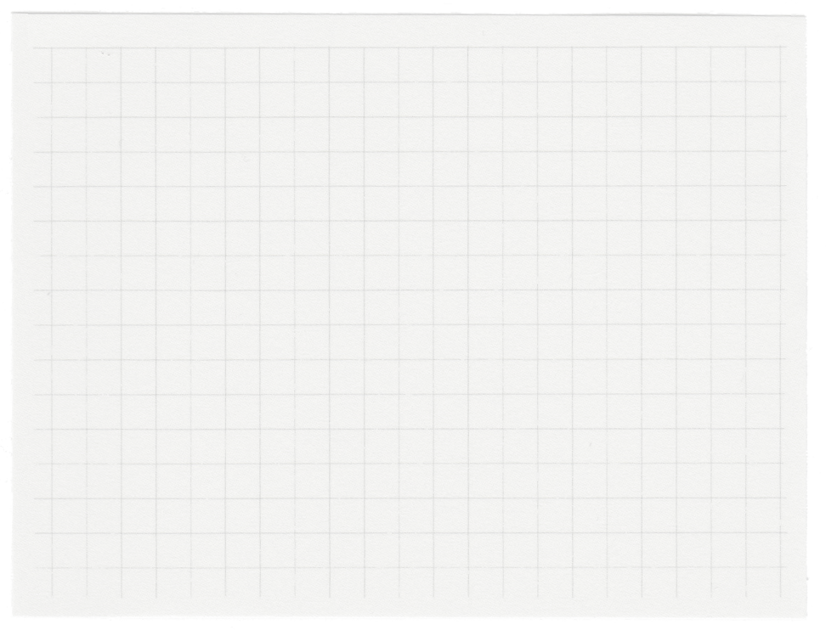













Dispatch & Delivery Management App
Presented by Team 2

Slide 2

Overview
This App is to revolutionize urban logistics in San Francisco, including ground robot assistants and drones, to provide efficient, reliable, and eco-friendly delivery solutions. It leverages the powerful Distance Matrix API to calculate travel time and distance for multiple destinations, offering an advanced shipping recommendation service. The service is designed to optimize logistics by providing users with three distinct shipping options to meet various needs:
Recommended Option: Balances speed and price, offering the optimal solution for most users.
Fastest Option: Prioritizes transit time, ensuring the quickest delivery but at a higher cost.
Cheapest Option: Focuses on cost savings, providing the most economical shipping solution.

Slide 3







Distance Matrix API Integration
Fetches real-time travel time and distance data for multiple destinations.
Payment Integration
The app integrates with the Stripe API to facilitate secure and seamless payment processing.
Key Features
Shipping Recommendations
Based on the pickup location andd delivery address, users receive tailored shipping options.
Order Tracking
Users can track their orders using the order ID without login.
Exploring the App
Automated Dispatching :
Automate the assignment of orders to the nearest distribution center using the shortest route.
User Account Features
The app allows users to access their order history

Slide 4
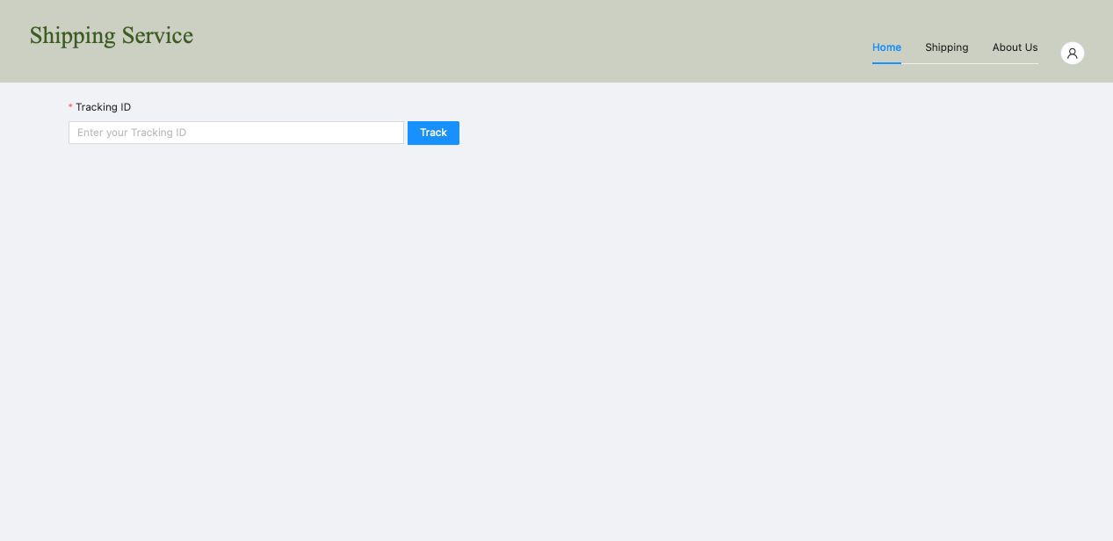
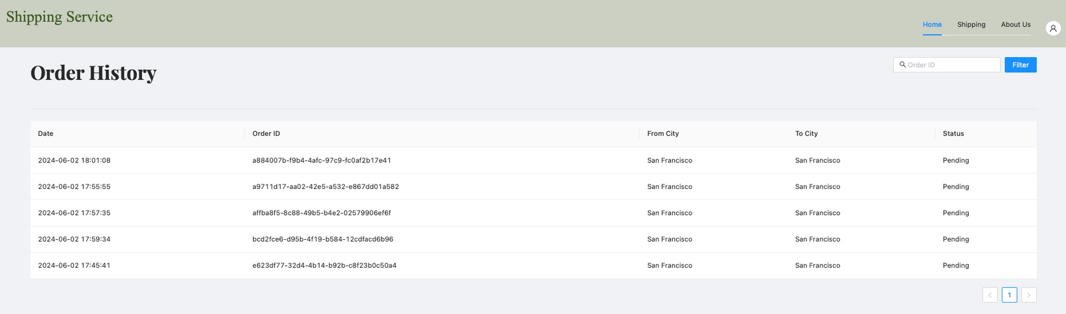
User Interface
This page collects shipping Info, provides recommendation, creates orders and redirects user to payment processing page
Sign Up, Log In, Log Out Button
Home Page without Login
Track Order
Home Page after Login

Slide 5
Technology Stack
Frontend
Backend
Database
Other Tool
Programming Languages:
JavaScript
Framework and Libraries:
React
Ant Design
Programming Languages:
Go (Golang)
Frameworks and Libraries:
Go package http, url, sql, json, etc.
Authentication and Security:
Middleware for JSON Web Token (JWT)
Utility Libraries:
uuid
Routing and Middleware:
Gorilla Web Toolkit
Payment Processing
Strip API
Map Routing:
Distance Matrix API
MySQL
Docker

Slide 6

Demonstration
Sign Up & Sign In
Enter Shipping Info
Get Recommendation
Submit Order
Process Payment
Order History
Track Order

Slide 7
Future Enhancements
Dispatching System
Order & Recommendation System
User Account Features
Routing Performance Optimization
Implement routing optimization to allow for multiple stops, maximizing cost savings and operational efficiency.
Robot & Drone Management System
Develop a management system for robots and drones to enhance dispatching performance and streamline logistics operations.
Optional Services
Provide additional services such as specifying delivery times and pickup times for added convenience.
Weight Restraint
Implement a system to ensure all orders adhere to the weight limitations of the robots and drones, enhancing safety and efficiency.
Quote and Order Placement Without Login
Allow all users to obtain shipping quotes and place orders without the need to log in, simplifying the process for new and occasional users.
Address Book
Allow users to save frequently used addresses for quick access and efficient order placement.
Real-Time Order History Status Updates
Offer real-time updates for order status, keeping users informed about their deliveries.
Order Search & Detail Review
Enable users to search through their order history. Allow users to review detailed information about their orders, including item specifics and delivery preferences.
Member Reward System
Introduce a subscription and membership benefit system to reward loyal users and encourage frequent usage.

Slide 8
Thank you very much!
Team 2

